Slide 1
An Urban Truck Scheduling and Routing Problem
By Zeyu Liu, Zefeng Lv, Rui Zhou

Slide 2

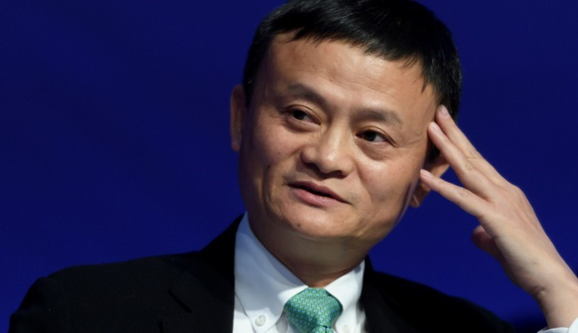

Slide 3
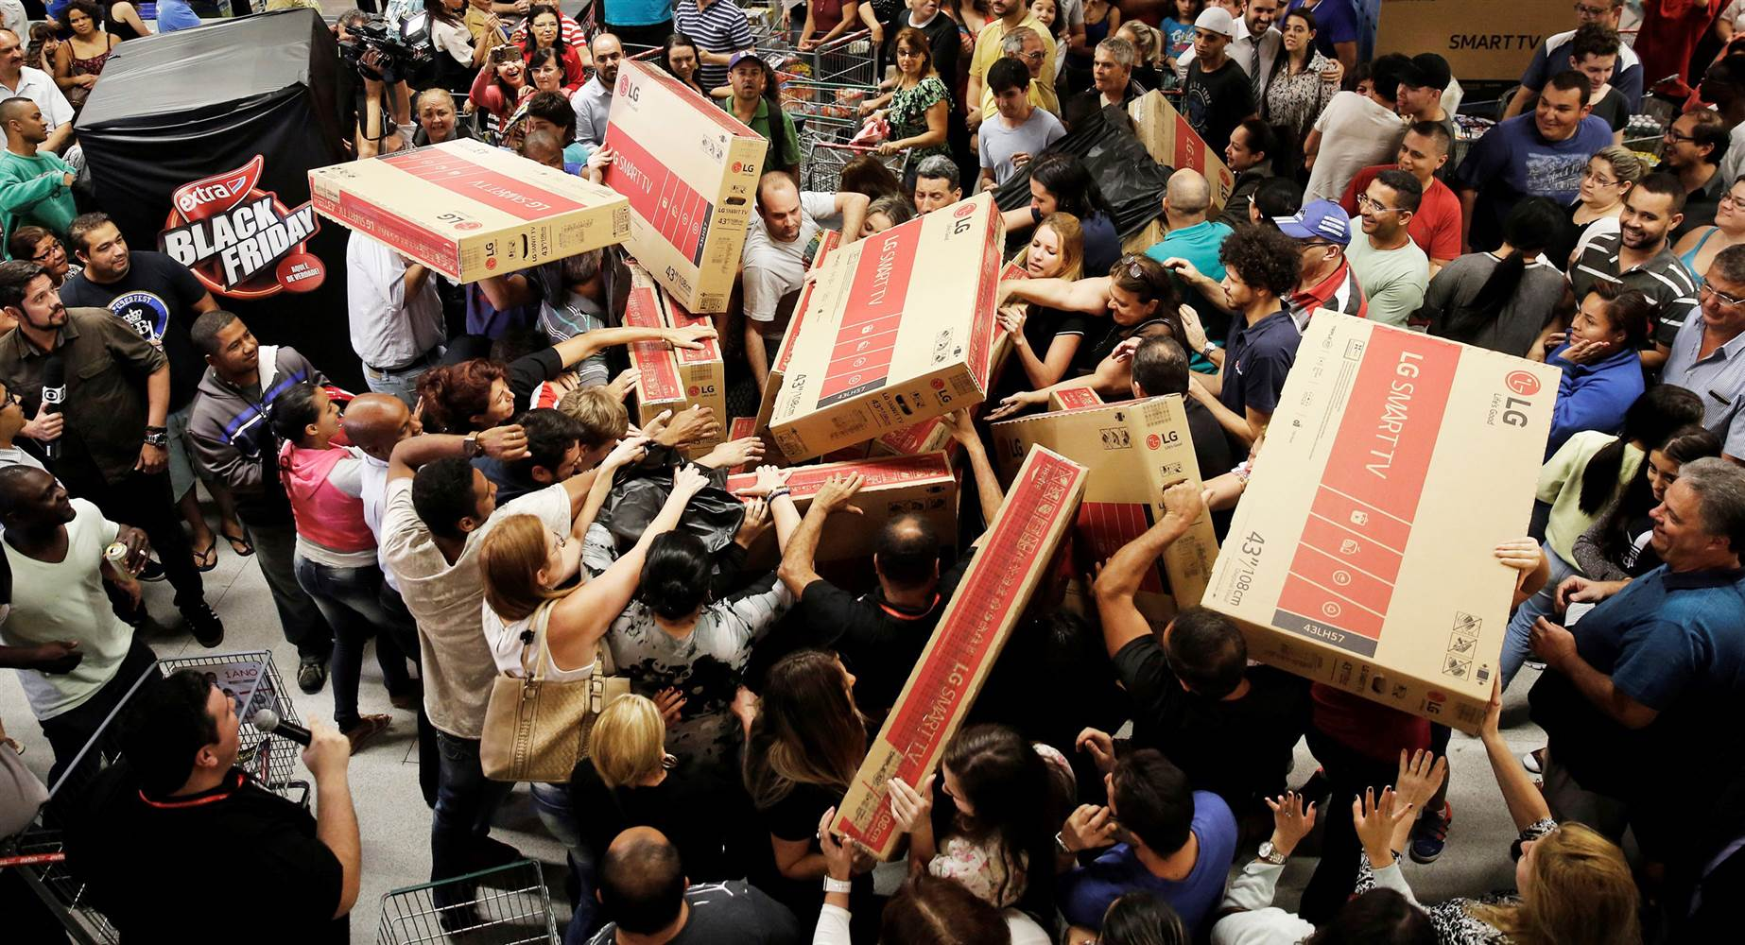

Slide 4
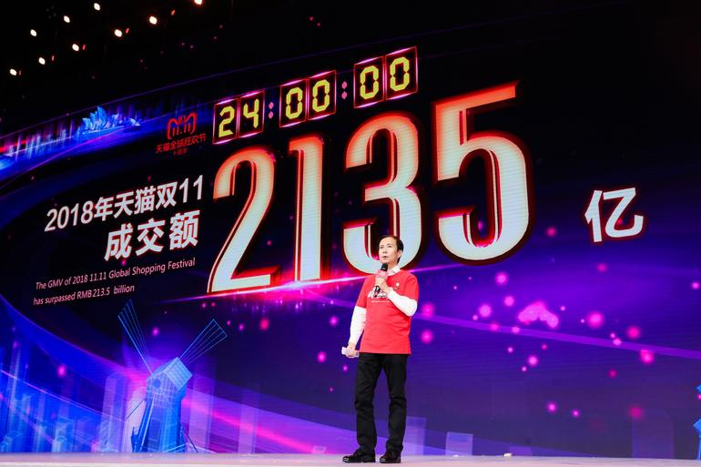

Slide 5
Double Eleven
10 billion yuan in 125 seconds ($ 1.4 billion)
213.5 billion yuan in 24 hours ($ 30.5 billion)
812 million goods
2 - 7 days (no shipping fee)
1 - 2 days ($ 2)

Slide 6

Jing Dong
Better quality
Better logistics (next day delivery)

Slide 7
What’s our problem?
One distribution center
More than 1000 customers
Decisions
How many trucks?
What’s the route?

Slide 8
Objective function
Minimize the total cost: fixed cost, traveling cost, waiting cost
Constraints
Driving range
Weight and volume capacity
Time window
Others: Recharge, multi-trips, heterogeneous fleet.

Slide 9
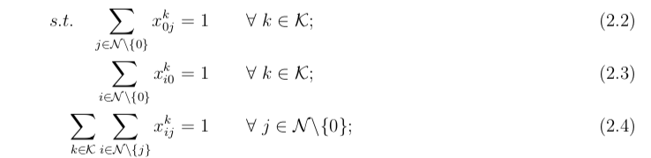
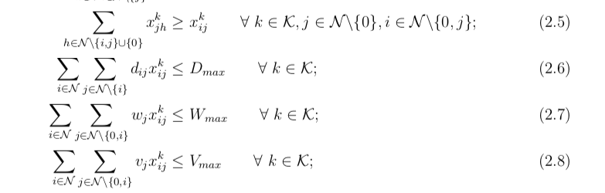
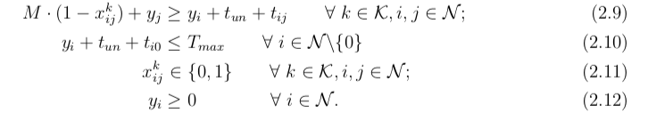

Slide 10
Data sample
Node ID | Longitude | Latitude | Package Weight (tons) | Package Volume (cubic meters) | Earliest Time | Latest Time
1 | 116.242043 | 40.072630 | 0.20760 | 0.3666 | 09:00 | 12:00
2 | 116.403595 | 39.872945 | 0.05863 | 0.1687 | 13:30 | 14:00
3 | 116.186289 | 40.016361 | 0.03645 | 0.0745 | 13:00 | 15:00
4 | 116.508011 | 39.826296 | 0.02595 | 0.0542 | 09:00 | 10:00
5 | 116.130997 | 39.825921 | 0.0198 | 0.1117 | 11:00 | 13:30
… | … | … | … | … | … | …
50 | 116.214509 | 40.122890 | 0.01697 | 0.0260 | 11:00 | 12:00

Slide 11
Data sample
From Node | To Node | Distance (kilometers) | Transport Time (minutes)
0 | 1 | 63536 | 77
0 | 2 | 27489 | 33
0 | 3 | 62041 | 75
0 | 4 | 13365 | 17
0 | 5 | 45570 | 55
… | … | … | …

Slide 12

Complexity
Consider a smaller problem, with 50 customer locations;
Number of decision variables = ${51}^{2}−51$=$2550$;
Binary combinations = $2^{2550}$.

Slide 13

Why not AnyLogic
Optimization iterations:
No more than 500 for Personal Learning Edition;
Compared to $2^{2550}$ combinations;

Slide 14
To simplify
Sampling data;
Using another solver.

Slide 15
Sampling
R (version 3.5.1);
Taking 50 customer locations:
with corresponding “distance”, “travel time”, etc.
R Code

Slide 16
Solving
Cplex (version 12.8)
with Python (version 3.6.5) API;
Python Code:
Main;
Model.

Slide 17
Solutions
Solution File

Slide 18
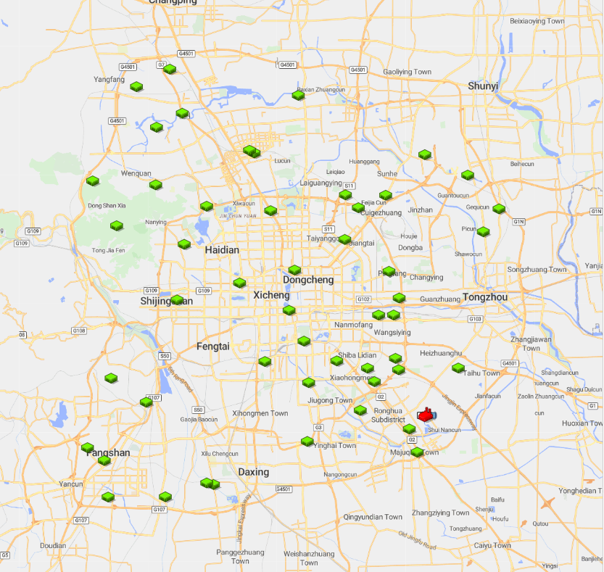
Anylogic Model
GIS MAP
1.Import database
2.Locate distributor and customers

Slide 19
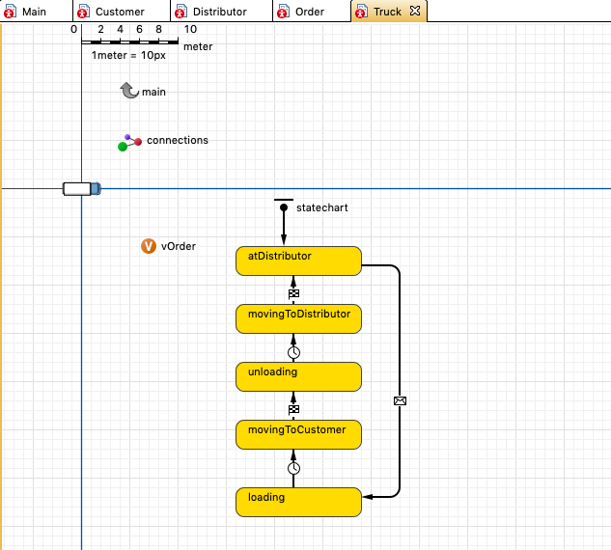
Truck

Slide 20
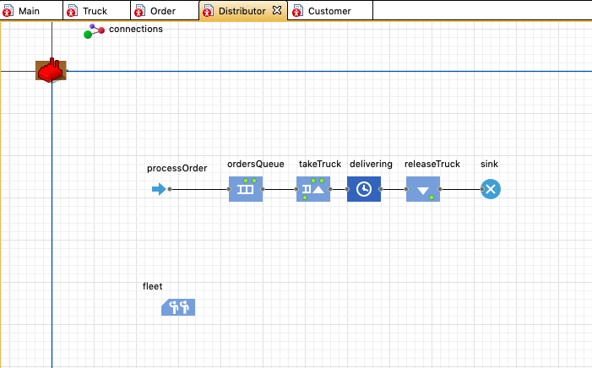
Distributor

Slide 21
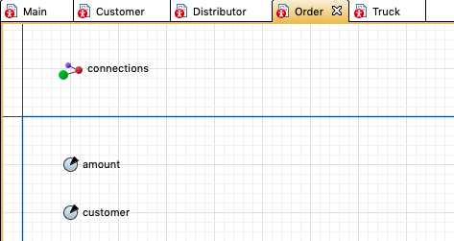
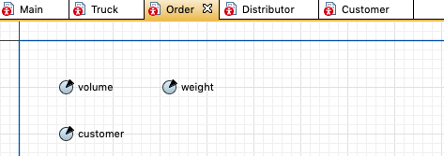
Order

Slide 22
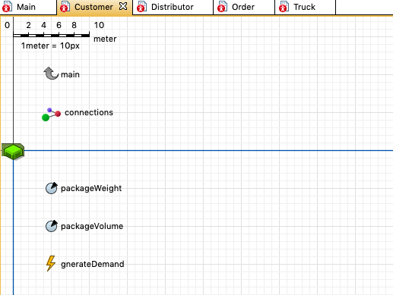
Customer

Slide 23
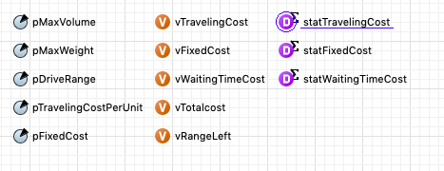
Variables

Slide 24
Future to Do
Import optimal route into AnyLogic
Get minimize total cost

